Slide 1

Task-6: Bank Loan Case Study

Slide 2

EXCEL FILE LINK FOR BANK LOAN PROJECT
https://drive.google.com/drive/folders/1eCWYStVJzokbkv-pFOrA0p39suJL3IbL?usp=sharing

Slide 3

Excel Tasks:
Identify Missing Data and Deal with it Appropriately
1
Identify Outliers in the Dataset
2
Analyse Data Imbalance
3
Perform Univariate, Segmented Univariate, and Bivariate Analysis
4
Identify Top Correlations for Different Scenarios
5

Slide 4

Project Details:
The Bank Loan Case Study project focuses on using Exploratory Data Analysis (EDA) to analyze data patterns and prevent the rejection of qualified loan applicants. The goal is to utilize Excel, data visualization, and statistical techniques for a thorough data analysis. This project aims to extract valuable insights and identify patterns that can indicate whether a customer may face challenges in repaying their installments.
Software Used: Microsoft Excel 365

Slide 5

DATA HANDLING
I looked at the data and understood all the columns. I noticed there are 128 columns and 49999 rows. The data has some unnecessary columns, empty values, and blank rows. I've decided to clean up the dataset completely.

Slide 6
1) Identify Missing Data and Deal with it Appropriately
DATA ANALYSIS
FUNTIONS USED:
You used two formulas, =COUNTBLANK(A2:A50000) and =COUNTBLANK(A2:A50000)/COUNTA(A2:A50000)*100, to count blank values in your data.
After finding the null values, you deleted columns where the null values were more than 25%. For the columns with less than 25% null values, you replaced them with the median using the =MEDIAN(J2:J50000) formula.
After these steps, you ended up with 72 columns and 49999 rows. This task helped you learn how to handle missing values in a large dataset effectively.

Slide 7
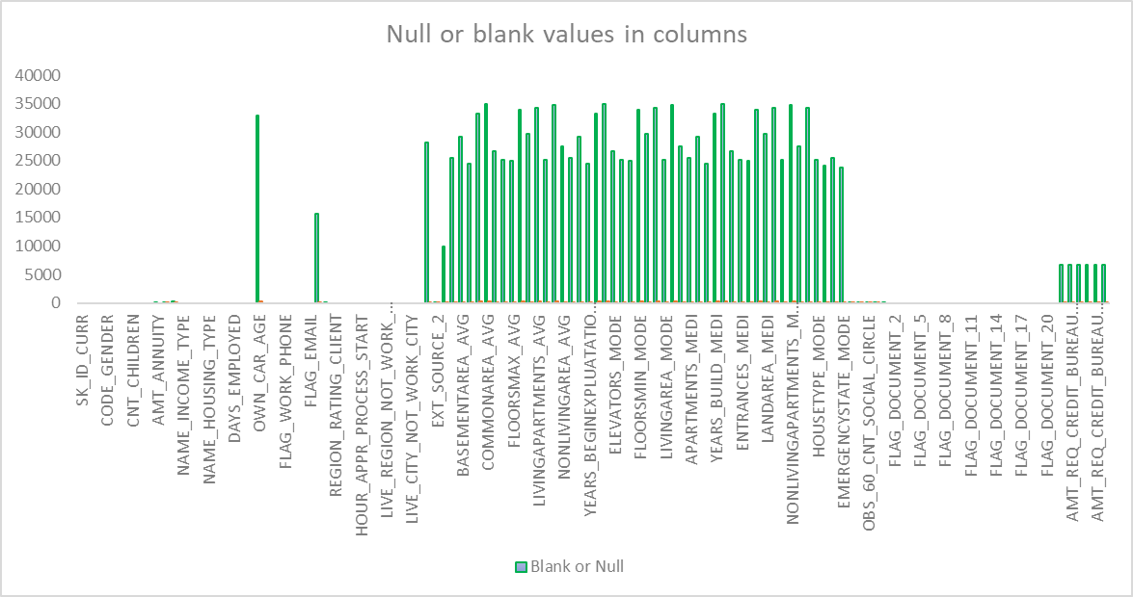
1) Identify Missing Data and Deal with it Appropriately
DATA ANALYSIS
Results: Before Cleaning

Slide 8
1) Identify Missing Data and Deal with it Appropriately
DATA ANALYSIS
Columns | total Null values | <25% | Average
EXT_SOURCE_3 | 9944 | 24.83 | 0.51
AMT_REQ_CREDIT_BUREAU_QRT | 6734 | 15.56 | 0.26
AMT_REQ_CREDIT_BUREAU_MON | 6734 | 15.56 | 0.27
AMT_REQ_CREDIT_BUREAU_DAY | 6734 | 15.56 | 0.01
AMT_REQ_CREDIT_BUREAU_WEEK | 6734 | 15.56 | 0.03
AMT_REQ_CREDIT_BUREAU_HOUR | 6734 | 15.56 | 0.01
AMT_REQ_CREDIT_BUREAU_YEAR | 6734 | 15.56 | 1.88
NAME_TYPE_SUITE | 192 | 0.38 | #DIV/0!
OBS_60_CNT_SOCIAL_CIRCLE | 168 | 0.34 | 1.40
OBS_30_CNT_SOCIAL_CIRCLE | 168 | 0.34 | 1.42
DEF_30_CNT_SOCIAL_CIRCLE | 168 | 0.34 | 0.14
DEF_60_CNT_SOCIAL_CIRCLE | 168 | 0.34 | 0.10
EXT_SOURCE_2 | 126 | 0.25 | 0.51
AMT_GOODS_PRICE | 38 | 0.08 | 539060.04
DAYS_LAST_PHONE_CHANGE | 1 | 0.00 | -964.30
AMT_ANNUITY | 1 | 0.00 | 27107.38
CNT_FAM_MEMBERS | 1 | 0.00 | 2.16
Results: After Cleaning
I filled in missing values in columns where there were less than 25% null values.
For columns, I found the most common text and used that to replace the missing values.

Slide 9
2) Identify Outliers in the Dataset:
Functions Used:
=QUARTILE.EXC(A2:A50000,1) [QUARTILE-1]
=QUARTILE.EXC(A2:A50000,3) [QUARTILE-3]
=N2-M2 [IQR]
=M2-1.5*O2 [LOWER BOUND]
=N2+1.5*O2 [UPPER BOUND]
I have Calculated Quartile-1, Quartile-2, Inter Quartile Range (IQR), Lower Bound, Upper Bound.

Slide 10
2) Identify Outliers in the Dataset:
Results:
Column | QUARTILE Q1 | QUARTILE Q3 | Inter Quartile Range IQR | Lower Bound | Upper Bound
CNT_CHILDREN | 0 | 1 | 1 | -1.5 | 2.5
AMT_INCOME_TOTAL | 112500 | 202500 | 90000 | -22500 | 337500
AMT_CREDIT | 270000 | 808650 | 538650 | -537975 | 1616625
AMT_ANNUITY | 16456.5 | 34596 | 18139.5 | -10752.75 | 61805.25
AMT_GOODS_PRICE | 238500 | 679500 | 441000 | -423000 | 1341000
DAYS_BIRTH | -19644 | -12378 | 7266 | -30543 | -1479
DAYS_EMPLOYED | -2786 | -292 | 2494 | -6527 | 3449
DAYS_REGISTRATION | -7464 | -1998 | 5466 | -15663 | 6201
DAYS_ID_PUBLISH | -4297 | -1722 | 2575 | -8159.5 | 2140.5
DAYS_LAST_PHONE_CHANGE | -1573 | -270 | 1303 | -3527.5 | 1684.5

Slide 11
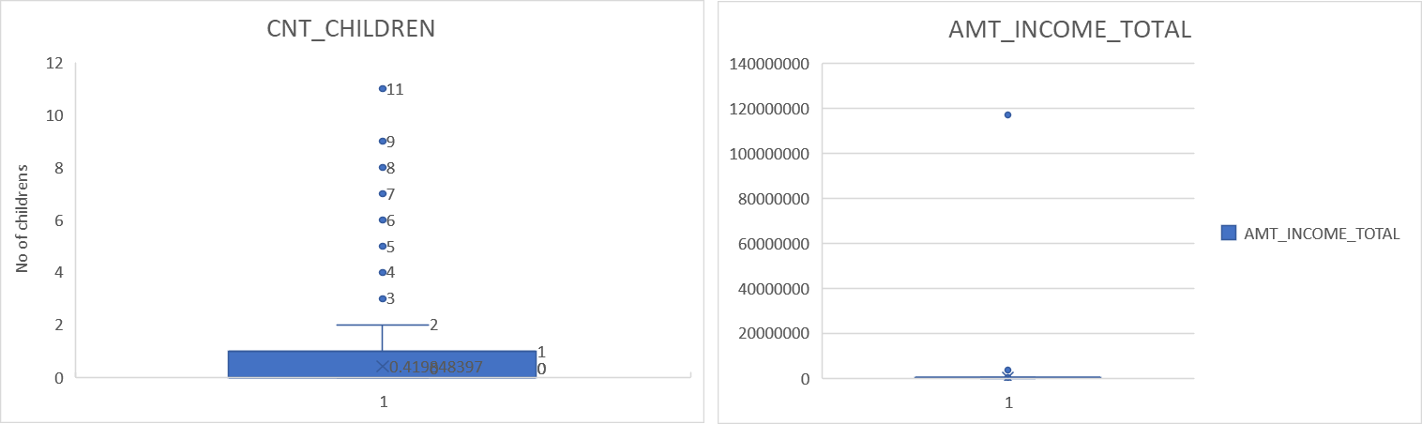
2) Identify Outliers in the Dataset:
Results:

Slide 12
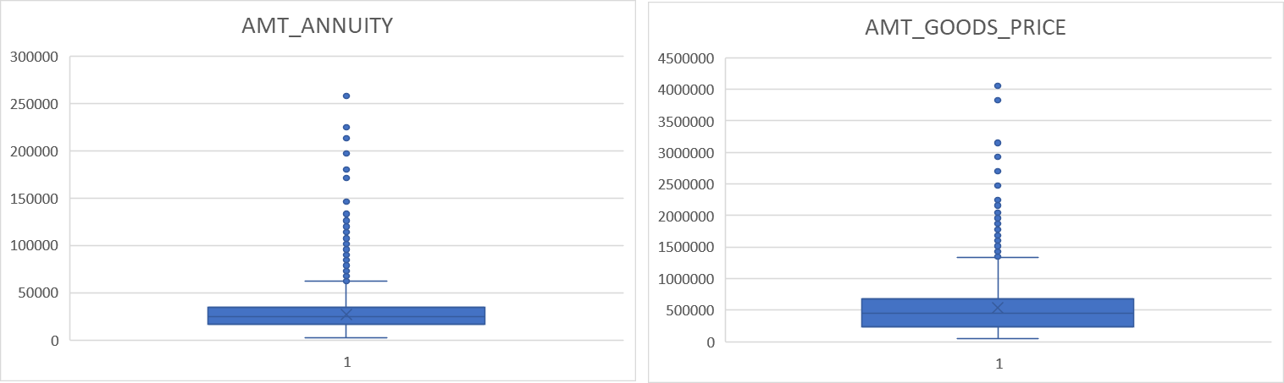
2) Identify Outliers in the Dataset:
Results:

Slide 13
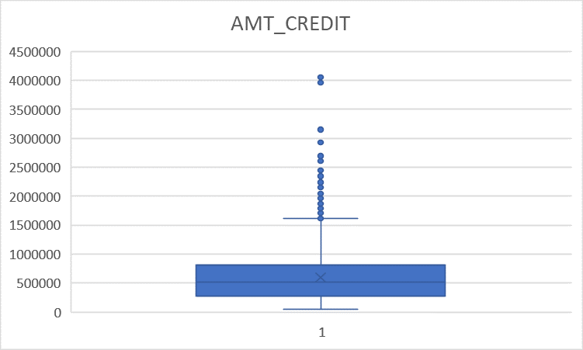
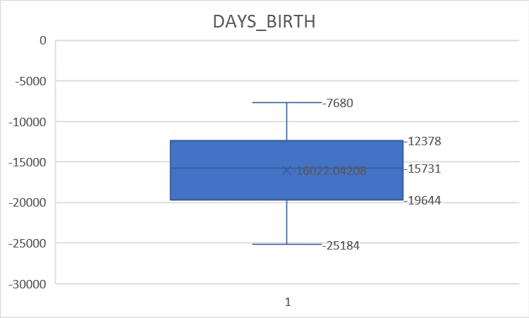
2) Identify Outliers in the Dataset:
Results:

Slide 14
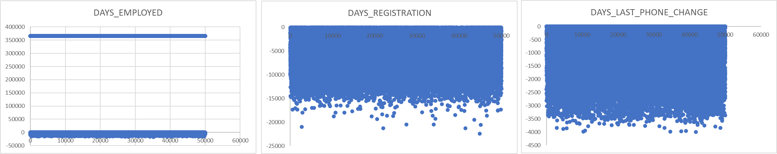
2) Identify Outliers in the Dataset:
Results:

Slide 15
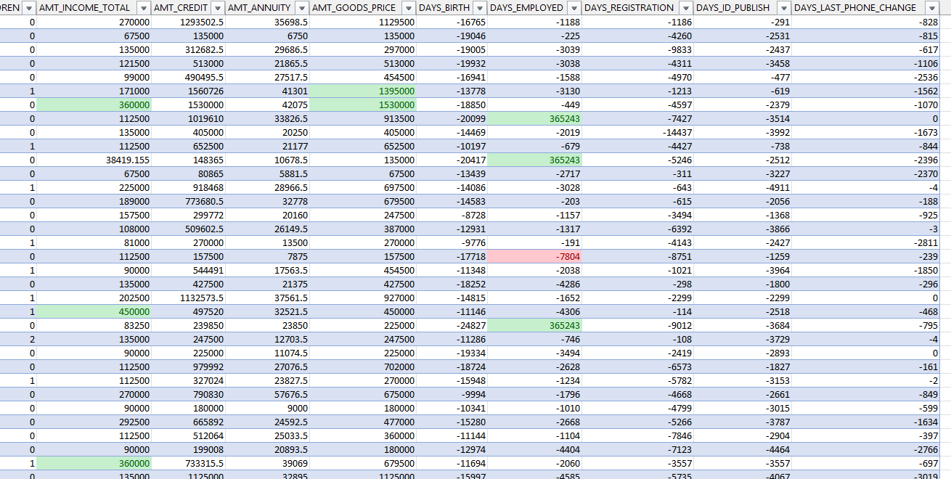
2) Identify Outliers in the Dataset:
Results:
highlighted the columns using conditional formatting of upper bound and lower bound

Slide 16
3) Analyse Data Imbalance:
Functions used:
use the UNIQUE function to find the unique values in column B from cells 2 to 50000. Additionally,
the COUNTIF function to calculate the occurrences of either 1 or 0 in that column.
for the imbalance ratio, o divide the count of occurrences for one scenario by the count for the other.

Slide 17
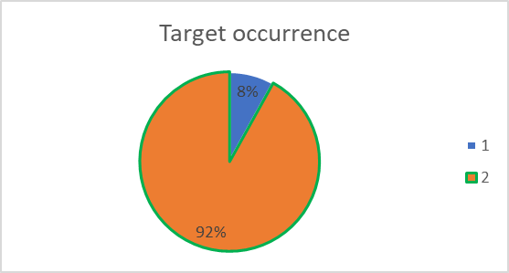
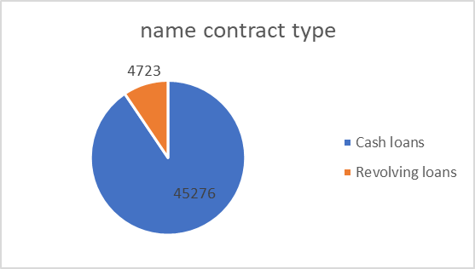
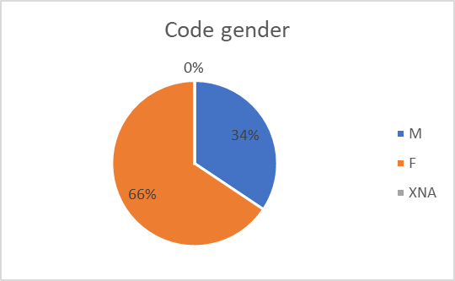
3) Analyse Data Imbalance:
TARGET | occurrence | imbalance ratio
1 | 4026 | 8.757314076
0 | 45973
NAME_CONTRACT_TYPE | occurrence | imbalance ratio
Cash loans | 45276 | 10.43157523
Revolving loans | 4723
CODE_GENDER | occurrence | imbalance ratio
M | 17174 | 52.32306614
F | 32823
XNA | 2

Slide 18
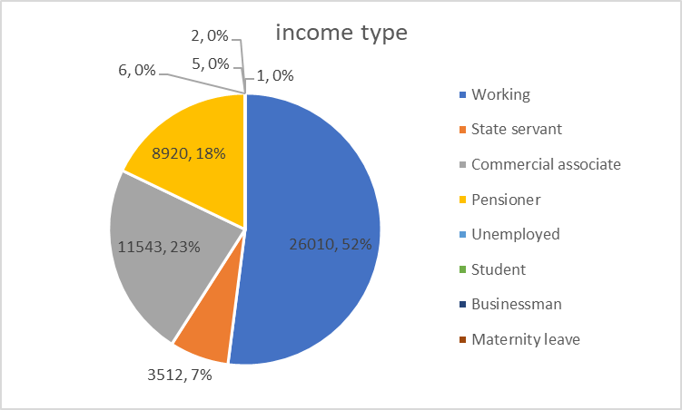
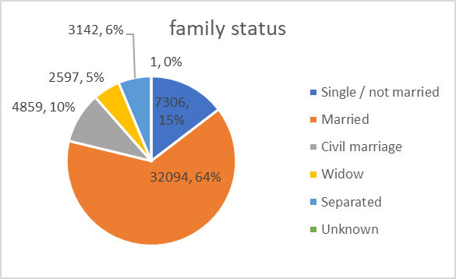
3) Analyse Data Imbalance:
NAME_INCOME_TYPE | occurrence
Working | 26010
State servant | 3512
Commercial associate | 11543
Pensioner | 8920
Unemployed | 6
Student | 5
Businessman | 2
Maternity leave | 1
NAME_FAMILY_STATUS | occurrence
Single / not married | 7306
Married | 32094
Civil marriage | 4859
Widow | 2597
Separated | 3142
Unknown | 1

Slide 19
4) Perform Univariate, Segmented Univariate and Bivariate Analysis:
I have created pivot table.
Calculate mean,mode,median,std dev using excel inbuilt functions
columns | AMT_INCOME_TOTAL | AMT_CREDIT | AMT_ANNUITY | DAYS_BIRTH | AGE
mean | 170767.5905 | 599700.5815 | 27107.33399 | 16022.04208 | 45
median | 145800 | 514777.5 | 24939 | 15731 | 44
mode | 135000 | 450000 | 9000 | 11039 | 31
std dev | 531813.7768 | 402405.2266 | 14562.6564 | 4361.356655 | 12

Slide 20
4) Perform Univariate, Segmented Univariate and Bivariate Analysis:
Univariate Results:
NAME_CONTRACT_TYPE | occurrence
Cash loans | 45276
Revolving loans | 4723
CODE_GENDER | occurrence
M | 17174
F | 32823
XNA | 2
Row Labels | Count of NAME_TYPE_SUITE
Unaccompanied | 40585
Family | 6577
Spouse, partner | 1855
Children | 546
Other_B | 260
Other_A | 139
Group of people | 37

Slide 21
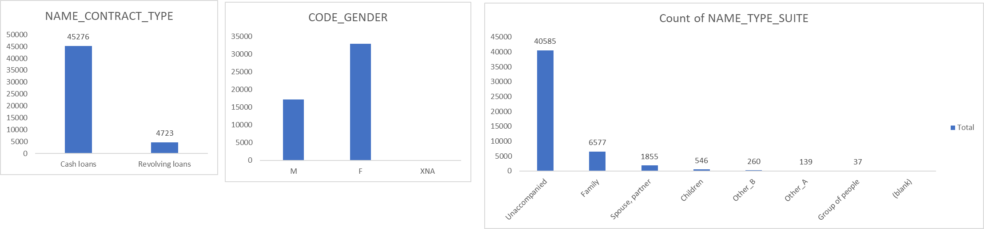
4) Perform Univariate, Segmented Univariate and Bivariate Analysis:
Univariate Results:

Slide 22
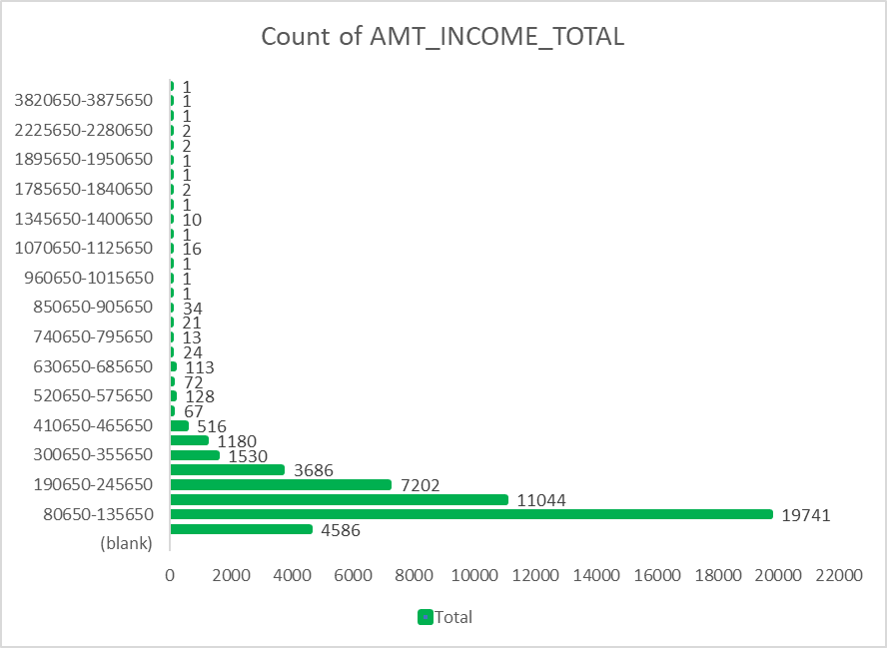
4) Perform Univariate, Segmented Univariate and Bivariate Analysis:
Univariate Results:
Row Labels | Count of AMT_INCOME_TOTAL
(blank)
25650-80650 | 4586
80650-135650 | 19741
135650-190650 | 11044
190650-245650 | 7202
245650-300650 | 3686
300650-355650 | 1530
355650-410650 | 1180
410650-465650 | 516
465650-520650 | 67
520650-575650 | 128
575650-630650 | 72
630650-685650 | 113
685650-740650 | 24
740650-795650 | 13

Slide 23
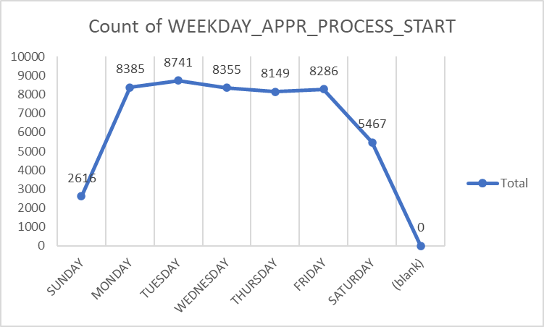
4) Perform Univariate, Segmented Univariate and Bivariate Analysis:
DATA ANALYSIS
Univariate Results:
Row Labels | Count of WEEKDAY_APPR_PROCESS_START
SUNDAY | 2616
MONDAY | 8385
TUESDAY | 8741
WEDNESDAY | 8355
THURSDAY | 8149
FRIDAY | 8286
SATURDAY | 5467

Slide 24
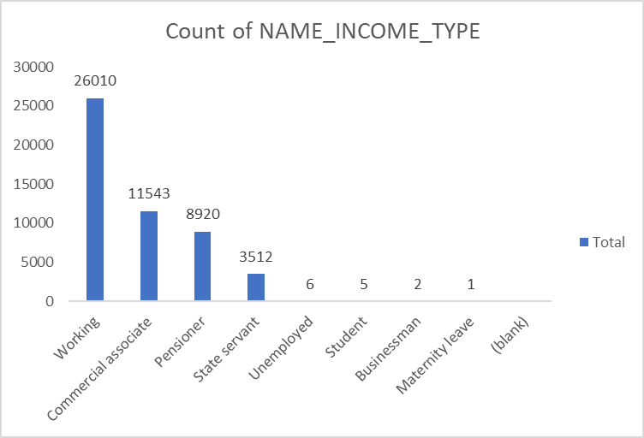
4) Perform Univariate, Segmented Univariate and Bivariate Analysis:
Univariate Results:
Row Labels | Count of NAME_INCOME_TYPE
Working | 26010
Commercial associate | 11543
Pensioner | 8920
State servant | 3512
Unemployed | 6
Student | 5
Businessman | 2
Maternity leave | 1

Slide 25
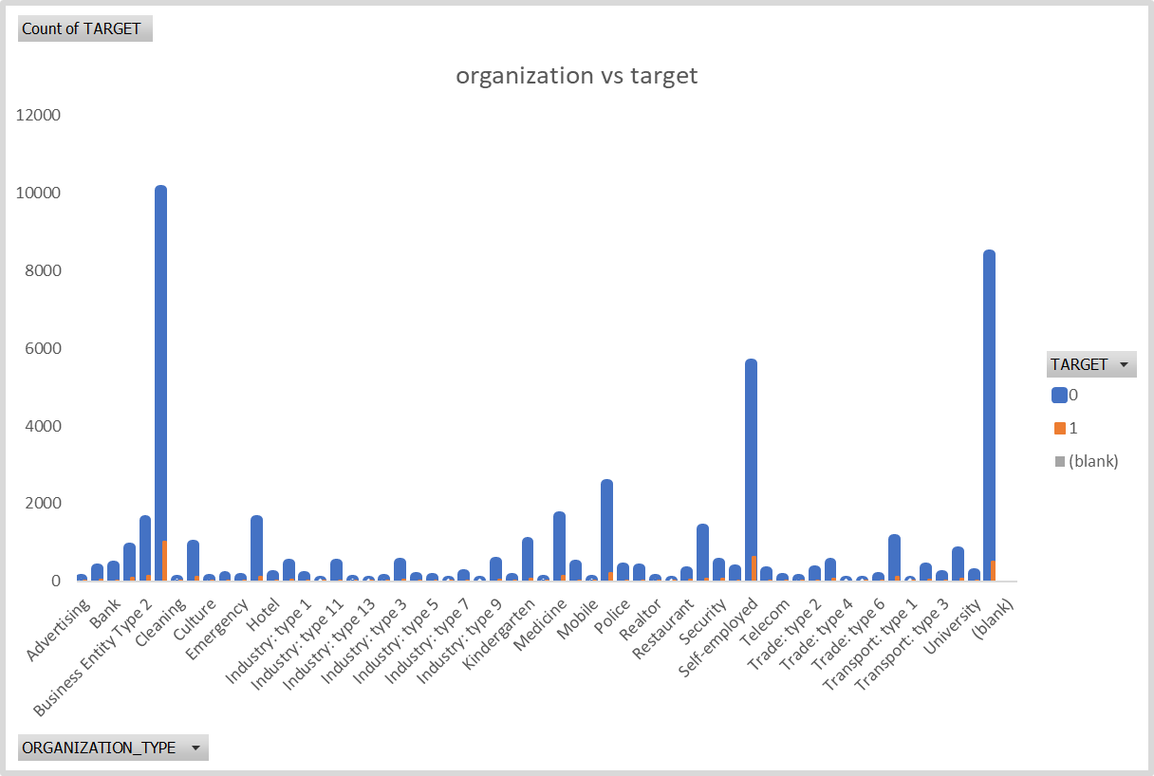
4) Perform Univariate, Segmented Univariate and Bivariate Analysis:
Segment Univariate & Bivariate Results:
Count of TARGET | Column Labels
Row Labels | 0 | 1 | (blank) | Grand Total
Advertising | 61 | 7 |  | 68
Agriculture | 341 | 51 |  | 392
Bank | 408 | 27 |  | 435
Business Entity Type 1 | 865 | 88 |  | 953
Business Entity Type 2 | 1571 | 133 |  | 1704
Business Entity Type 3 | 10087 | 1014 |  | 11101
Cleaning | 37 | 3 |  | 40
Construction | 958 | 108 |  | 1066
Culture | 62 | 2 |  | 64
Electricity | 134 | 13 |  | 147
Emergency | 86 | 7 |  | 93
Government | 1592 | 124 |  | 1716
Hotel | 169 | 13 |  | 182
Housing | 447 | 42 |  | 489
Industry: type 1 | 140 | 19 |  | 159
Industry: type 10 | 20 | 1 |  | 21
Industry: type 11 | 461 | 28 |  | 489
Industry: type 12 | 50 | 3 |  | 53
Industry: type 13 | 11 | 4 |  | 15
Industry: type 2 | 68 | 10 |  | 78

Slide 26
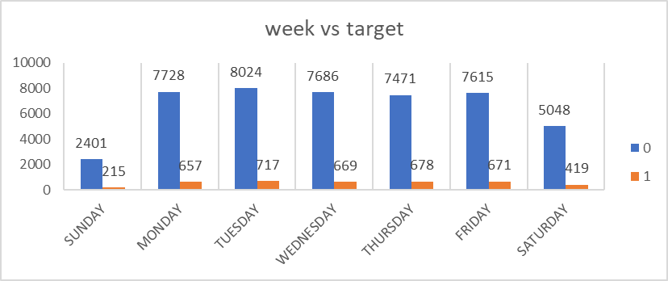
4) Perform Univariate, Segmented Univariate and Bivariate Analysis:
Segment Univariate & Bivariate Results:
week | Column Labels
Row Labels | 0 | 1 | Grand Total
SUNDAY | 2401 | 215 | 2616
MONDAY | 7728 | 657 | 8385
TUESDAY | 8024 | 717 | 8741
WEDNESDAY | 7686 | 669 | 8355
THURSDAY | 7471 | 678 | 8149
FRIDAY | 7615 | 671 | 8286
SATURDAY | 5048 | 419 | 5467

Slide 27
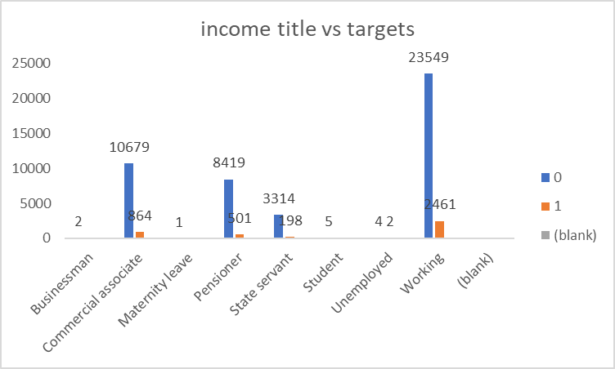
4) Perform Univariate, Segmented Univariate and Bivariate Analysis:
Segment Univariate & Bivariate Results:
Count of TARGET | Column Labels
Row Labels | 0 | 1 | (blank) | Grand Total
Businessman | 2 |  |  | 2
Commercial associate | 10679 | 864 |  | 11543
Maternity leave | 1 |  |  | 1
Pensioner | 8419 | 501 |  | 8920
State servant | 3314 | 198 |  | 3512
Student | 5 |  |  | 5
Unemployed | 4 | 2 |  | 6
Working | 23549 | 2461 |  | 26010

Slide 28
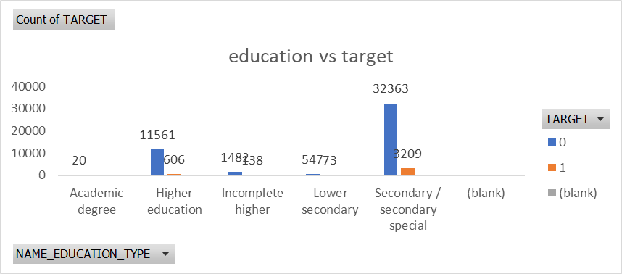
4) Perform Univariate, Segmented Univariate and Bivariate Analysis:
Segment Univariate & Bivariate Results:
Count of TARGET | Column Labels
Row Labels | 0 | 1
Academic degree | 20
Higher education | 11561 | 606
Incomplete higher | 1482 | 138
Lower secondary | 547 | 73
Secondary / secondary special | 32363 | 3209
(blank)

Slide 29
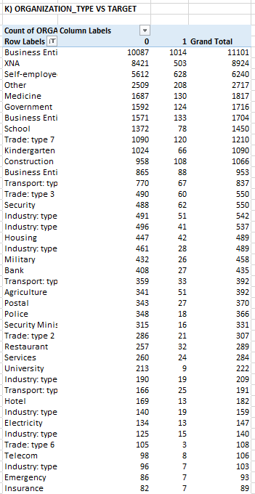
4) Perform Univariate, Segmented Univariate and Bivariate Analysis:
DATA ANALYSIS
Segment Univariate & Bivariate Results:

Slide 30
5) Identify Top Correlations for different scenarios:
Functions used:
I found correlation between target and various columns by using below function:
=CORREL(D2:D50000,C2:C50000)
Then find each corelation where target=0 and target=1

Slide 31
5) Identify Top Correlations for different scenarios:
Results: correlation for 0&1
Column | CNT_CHILDREN | AMT_INCOME_TOTAL | AMT_CREDIT | AMT_ANNUITY | AMT_GOODS_PRICE | DAYS_BIRTH | DAYS_EMPLOYED | DAYS_REGISTRATION | DAYS_ID_PUBLISH | CNT_FAM_MEMBERS | REGION_RATING_CLIENT | REGION_RATING_CLIENT_W_CITY | DAYS_LAST_PHONE_CHANGE
CNT_CHILDREN | 1
AMT_INCOME_TOTAL | 0.009589 | 1
AMT_CREDIT | 0.004972 | 0.069316 | 1
AMT_ANNUITY | 0.02618 | 0.083008 | 0.769499 | 1
AMT_GOODS_PRICE | 0.000233 | 0.069892 | 0.986704 | 0.774134 | 1
DAYS_BIRTH | 0.329264 | 0.016003 | -0.05934 | 0.007708 | -0.05767 | 1
DAYS_EMPLOYED | -0.23969 | -0.03162 | -0.07047 | -0.11045 | -0.06779 | -0.61355 | 1
DAYS_REGISTRATION | 0.181217 | 0.009952 | 0.003449 | 0.033219 | 0.006084 | 0.333633 | -0.20468 | 1
DAYS_ID_PUBLISH | -0.03212 | 0.003507 | -0.01223 | 0.006717 | -0.01403 | 0.270825 | -0.27038 | 0.104299 | 1
CNT_FAM_MEMBERS | 0.880453 | 0.011226 | 0.063997 | 0.07738 | 0.061573 | 0.277241 | -0.22982 | 0.170109 | -0.02607 | 1
REGION_RATING_CLIENT | 0.025914 | -0.03819 | -0.10051 | -0.1258 | -0.10364 | 0.016779 | 0.034322 | 0.087518 | -0.00231 | 0.025985 | 1
REGION_RATING_CLIENT_W_CITY | 0.022778 | -0.04072 | -0.10949 | -0.13932 | -0.11171 | 0.014552 | 0.03683 | 0.079792 | -0.00731 | 0.025165 | 0.95071 | 1
DAYS_LAST_PHONE_CHANGE | -0.00203 | -0.0048 | -0.07618 | -0.06726 | -0.07971 | 0.080196 | 0.027516 | 0.052146 | 0.09138 | -0.02271 | 0.027327 | 0.026789 | 1

Slide 32
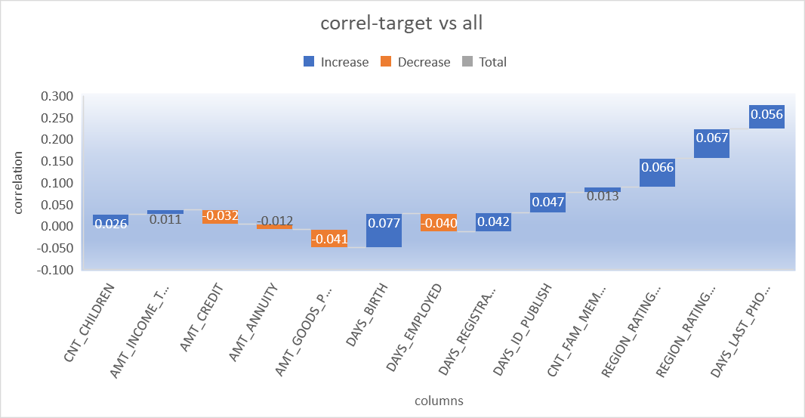
5) Identify Top Correlations for different scenarios:
Results: correlation for 0&1
columns | target
CNT_CHILDREN | 0.026
AMT_INCOME_TOTAL | 0.011
AMT_CREDIT | -0.032
AMT_ANNUITY | -0.012
AMT_GOODS_PRICE | -0.041
DAYS_BIRTH | 0.077
DAYS_EMPLOYED | -0.040
DAYS_REGISTRATION | 0.042
DAYS_ID_PUBLISH | 0.047
CNT_FAM_MEMBERS | 0.013
REGION_RATING_CLIENT | 0.066
REGION_RATING_CLIENT_W_CITY | 0.067
DAYS_LAST_PHONE_CHANGE | 0.056

Slide 33
5) Identify Top Correlations for different scenarios:
Results: correlation for 1
Column | CNT_CHILDREN | AMT_INCOME_TOTAL | AMT_CREDIT | AMT_ANNUITY | AMT_GOODS_PRICE | DAYS_BIRTH | DAYS_EMPLOYED | DAYS_REGISTRATION | DAYS_ID_PUBLISH | CNT_FAM_MEMBERS | REGION_RATING_CLIENT | REGION_RATING_CLIENT_W_CITY | DAYS_LAST_PHONE_CHANGE
CNT_CHILDREN | 1
AMT_INCOME_TOTAL | 0.01011 | 1
AMT_CREDIT | 0.007602 | 0.015271 | 1
AMT_ANNUITY | 0.029173 | 0.018005 | 0.749665 | 1
AMT_GOODS_PRICE | -0.00108 | 0.01327 | 0.982268 | 0.749504 | 1
DAYS_BIRTH | 0.249673 | 0.009034 | -0.14251 | -0.00875 | -0.14101 | 1
DAYS_EMPLOYED | -0.18932 | -0.01156 | 0.01604 | -0.07956 | 0.020235 | -0.58148 | 1
DAYS_REGISTRATION | 0.152113 | -0.00956 | -0.04284 | 0.021582 | -0.04332 | 0.288438 | -0.18872 | 1
DAYS_ID_PUBLISH | -0.04236 | -0.00912 | -0.04377 | -0.02132 | -0.04972 | 0.247897 | -0.23006 | 0.090291 | 1
CNT_FAM_MEMBERS | 0.892522 | 0.013122 | 0.061249 | 0.075838 | 0.055136 | 0.199141 | -0.18356 | 0.151787 | -0.04404 | 1
REGION_RATING_CLIENT | 0.055516 | -0.01285 | -0.04502 | -0.06158 | -0.0513 | 0.045027 | -0.00915 | 0.115625 | 0.025335 | 0.05728 | 1
REGION_RATING_CLIENT_W_CITY | 0.054802 | -0.01267 | -0.05295 | -0.07942 | -0.05669 | 0.038087 | -0.00414 | 0.108123 | 0.014431 | 0.057988 | 0.950769 | 1
DAYS_LAST_PHONE_CHANGE | 0.011339 | 0.012457 | -0.12454 | -0.10047 | -0.12883 | 0.124609 | -0.01573 | 0.078605 | 0.138088 | -0.00573 | 0.026186 | 0.022309 | 1

Slide 34
5) Identify Top Correlations for different scenarios:
Results: correlation for 0
Column | CNT_CHILDREN | AMT_INCOME_TOTAL | AMT_CREDIT | AMT_ANNUITY | AMT_GOODS_PRICE | DAYS_BIRTH | DAYS_EMPLOYED | DAYS_REGISTRATION | DAYS_ID_PUBLISH | CNT_FAM_MEMBERS | REGION_RATING_CLIENT | REGION_RATING_CLIENT_W_CITY | DAYS_LAST_PHONE_CHANGE
CNT_CHILDREN | 1
AMT_INCOME_TOTAL | 0.03632 | 1
AMT_CREDIT | 0.005705 | 0.377966 | 1
AMT_ANNUITY | 0.026384 | 0.451135 | 0.770773 | 1
AMT_GOODS_PRICE | 0.001518 | 0.384576 | 0.987 | 0.775835 | 1
DAYS_BIRTH | 0.335876 | 0.073769 | -0.05108 | 0.009911 | -0.04877 | 1
DAYS_EMPLOYED | -0.24359 | -0.1627 | -0.07737 | -0.11301 | -0.07511 | -0.61529 | 1
DAYS_REGISTRATION | 0.183072 | 0.068934 | 0.008054 | 0.034609 | 0.01126 | 0.335028 | -0.20437 | 1
DAYS_ID_PUBLISH | -0.03254 | 0.032286 | -0.00829 | 0.009427 | -0.00939 | 0.270073 | -0.27222 | 0.103549 | 1
CNT_FAM_MEMBERS | 0.879238 | 0.041599 | 0.064877 | 0.077893 | 0.062892 | 0.284379 | -0.23373 | 0.171483 | -0.02505 | 1
REGION_RATING_CLIENT | 0.021289 | -0.20503 | -0.10256 | -0.12992 | -0.10484 | 0.009025 | 0.040506 | 0.082563 | -0.0081 | 0.022204 | 1
REGION_RATING_CLIENT_W_CITY | 0.017873 | -0.22004 | -0.11164 | -0.1432 | -0.11312 | 0.007084 | 0.042899 | 0.074746 | -0.01267 | 0.021214 | 0.950468 | 1
DAYS_LAST_PHONE_CHANGE | -0.00482 | -0.0495 | -0.0712 | -0.06445 | -0.07424 | 0.07254 | 0.032952 | 0.04778 | 0.085063 | -0.02504 | 0.023515 | 0.023179 | 1

Slide 35
Insights for bank loan project
Some information is missing in our data. We've removed columns with a lot of missing info and filled in the gaps using typical values like the middle number or the most common one.
Our data has some weird values that don't fit the usual pattern. We need to use special methods to handle these oddities.
The data is not spread out evenly across different categories.
People with lower incomes, who are married, working, and around 38-39 years old, tend to apply for loans the most. Interestingly, they also have a higher chance of not repaying those loans.
Different pieces of information in our data are connected, and the most linked one is something called "DAYS_BIRTH."

Slide 36
EXCEL FILE LINK FOR BANK LOAN PROJECT
https://drive.google.com/drive/folders/1eCWYStVJzokbkv-pFOrA0p39suJL3IbL?usp=sharing

Slide 37

Conclusion
I have successfully completed project using Excel, Power point.
I have learned to deal with large datasets which has many missing values and outliers.
Thank You

